Slide 1
Face Mask Detection
Supervised by
Nibir Chandra Mandal
Md. Tanvir Rouf Shawon
Department of CSE
Ahsanullah University of Science & Technology
Presented By
Abiha Tahsin Chowdhury [18.01.04.126]
Barnana Prabenee Kristi [18.01.04.127]
Sadia Afsana Mumu [18.01.04.138]
Arpa Alam [18.01.04.143]

Slide 2
CONTENTS
Introduction
Motivation
Research Objective
Literature Review
Proposed Model
Dataset
Methodology
Result & Discussion
Conclusion
Future Work
Referenses

Slide 3
INTRODUCTION
Masks are a key measure to reduce transmission and save lives. Masks can be used for either protection of healthy persons or to prevent onward transmission, or both.
Face mask detection refers to detect whether a person is wearing a mask or not using different deep learning algorithms for the purpose of security , authentication and surveillance.
Deep learning has attracted increased interest in the field of object detection and has been utilized to construct a face mask detection tool that can determine whether or not a person is wearing a mask.

Slide 4
MOTIVATION
It is necessary to take action to stop the COVID19 pandemic from spreading and so mask recognition technique is an extremely effective approach to accomplish this.
For transportation networks, densely populated areas, residential neighborhoods, large-scale manufacturing, and other businesses, reliable face mask detection applications are desperately needed to ensure safety in the face of the present COVID-19 outbreak.

Slide 5
RESEARCH OBJETIVE
A Deep Learning-based system that can identify situations in which face masks are improperly worn.
Our approach is to use some deep learning architecture that can distinguish between faces that are covered with masks and those that are not.
Perceiving the most suitable methodology comparing the results of multiple algorithms and techniques.

Slide 6
LITERATURE REVIEW
Paper Title : An Automated System to Limit COVID-19 Using Facial Mask Detection in Smart City Network
Collected a total of 858 images of people with masks and 681 images of people without a mask.
Convolutional Neural Network(CNN) used for image classification which evaluates with 97%. Accuracy.

Slide 7
LITERATURE REVIEW [CONT..]
Paper Title : Automatic Detection of White Blood Cancer From Bone Marrow Microscopic Images Using Convolutional Neural Networks.
the dataset is acquired from two different subsets of a dataset collection ; Leukemia having 90 images and Multiple Myeloma having 100 images..
The technique used for classification of images is the convolutional neural network (CNN) and accuracy of 97.25% is achieved

Slide 8
LITERATURE REVIEW [CONT..]
Paper Title : Face mask recognition system using CNN
The dataset used in this project is a Face dataset (with/without mask) from Kaggle.
The dataset consists of 3,832 images divided into two mask classes: 1914 masked image and 1918 without masked image.
Convolutional Neural Network is used as model with 94% accuracy.

Slide 9
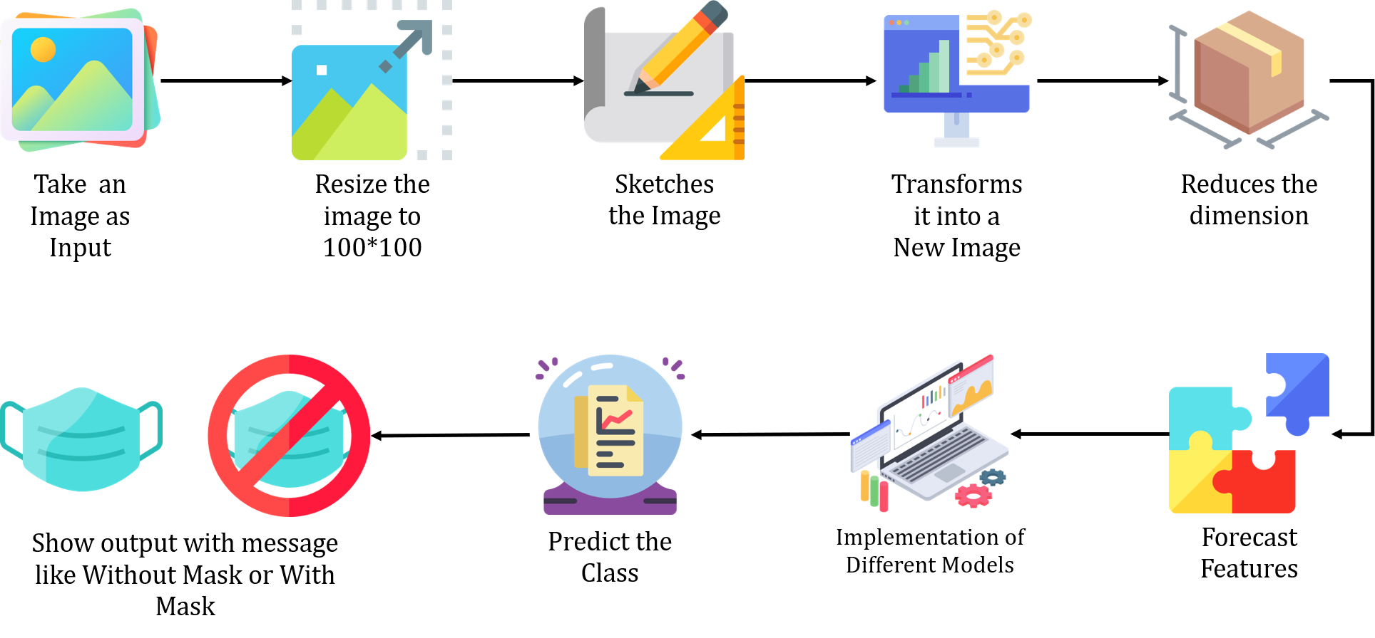



PROPOSED MODEL

Slide 10
DATASET
Data Collection
For datasets we have used Face Mask Detection 12K Images Dataset from Kaggle.
The data-set consists of 3 directories train, validation and test.
Each directories contains two categorized images with mask and without mask.
Train data consists of 10k images, validation data have 800 images and test data have 992 images .

Slide 11
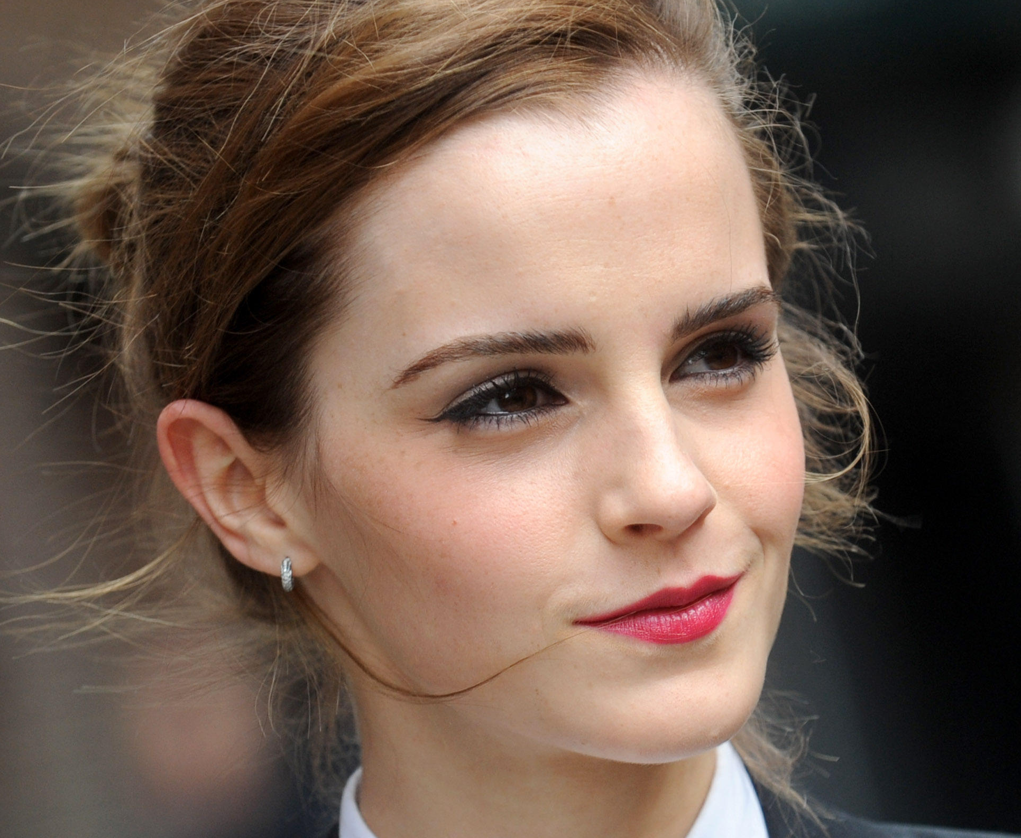
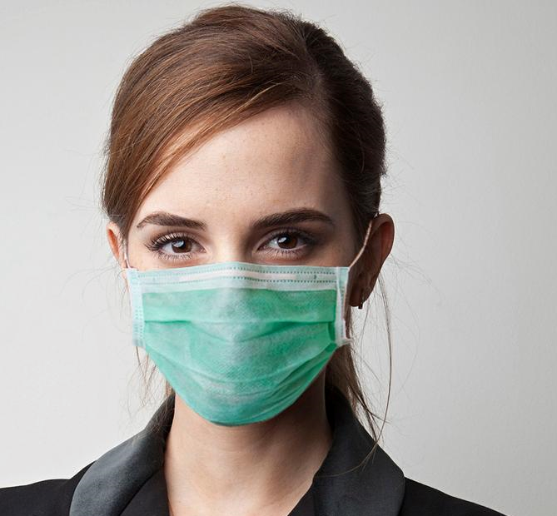
DATASET
Examples From Our Dataset
Without Mask With Mask

Slide 12
METHODOLOGY
Model Training
We used python script, tensor flow, and CNN, VGG16, RESNET50 etc. as deep learning architecture to develop an efficient network for recognizing facemasks.
The primary functionality is to extract characteristics from photographs and predict which class they belong to.
The dimensionality of photographs is reduced, the input image is resized then extract and forecast features.
Several models than deployed to train the preprocessed dataset.
For evaluating the performance of our chosen models, several performance metrics are used namely Accuracy, Precision, Recall and F1 Score.

Slide 13
METHODOLOGY
Convolutional Neural Network(CNN)
A convolutional neural network (CNN) is a type of artificial neural network used in image recognition and processing that is specifically designed to process pixel data. The layers of a CNN consist of an input layer, an output layer and a hidden layer that includes multiple convolutional layers, pooling layers, fully connected layers and normalization layers.
VGG16
VGG incorporates 1x1 convolutional layers to make the decision function more non-linear without changing the receptive fields. The small-size convolution filters allows VGG to have a large number of weight layers; of course, more layers leads to improved performance.

Slide 14
METHODOLOGY
RESNET50
A residual neural network (ResNet) is a kind of deep transfer learning based on residual learning. ResNet-50 with 50-layers are deep, start with convolution layer, and end with a fully-connected layer, and in between followed by 16 residual bottleneck blocks each block has three layers of convolution layer.
InceptionV3
Inception-v3 is a convolutional neural network that is 48 layers deep. The Inception V3 model used several techniques for optimizing the network for better model adaptation. It has a deeper network compared to the Inception V1 and V2 models, but its speed isn’t compromised.

Slide 15
RESULT AND DISCUSSION
Table 1. Comparison of Performance metrices of different model
Models | Accuracy | Precision | Recall | F1-Score
CNN | 97.35% | 94.34% | 97.32% | 91.79%
VGG16 | 98.79% | 51.08% | 51.67% | 50.57%
RESNET50 | 70.67% | 39.92% | 51.61% | 33.03%
InceptionV3 | 98.89% | 51.46% | 51.51% | 51.41%

Slide 16
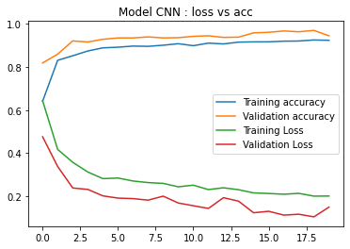
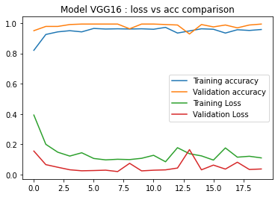
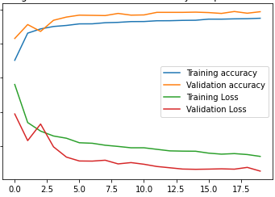
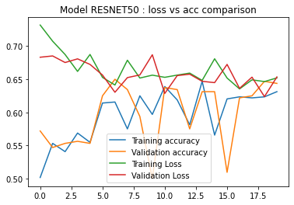
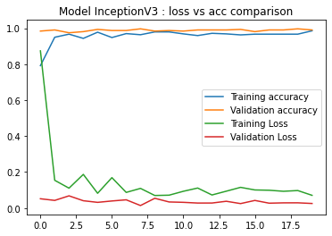
Loss vs Accuracy Curve Analysis

Slide 17
CONCLUSION
This face mask recognition technique is an extremely effective approach to reduce COVID19 from spreading and thus who are not wearing masks will be separated from the crowd by the system.
We illustrated the learning and performance task of the models by using some deep learning tools and techniques and achieved reasonably high accuracy for CNN.
The deployed model will contribute immensely to the public health care system.

Slide 18
FUTURE WORK
In future it can be extended to detect if a person is wearing the mask properly or not. The model can be further improved to detect if the mask is virus prone or not i.e. the type of the mask is surgical, N95 or not.
As far as now we deployed the detection technique only for images we might try to detect from videos also.

Slide 19
REFERENCES
[1] Rahman, Mohammad Marufur, et al. ”An automated system to limit
COVID-19 using facial mask detection in smart city network.” 2020
IEEE International IOT, Electronics and Mechatronics Conference
(IEMTRONICS). IEEE, 2020.
[2] Kumar, Deepika, et al. "Automatic detection of white blood cancer from bone marrow microscopic images using convolutional neural networks." IEEE Access 8 (2020): 142521-142531.
[3] Kaur, Gagandeep, Ritesh Sinha, Puneet Kumar Tiwari, Srijan Kumar
Yadav, Prabhash Pandey, Rohit Raj, Anshu Vashisth, and Manik Rakhra.
”Face mask recognition system using CNN model.” Neuroscience Infor-
matics (2021): 100035.

Slide 20
REFERENCES
[4] Haralick, Robert M., Karthikeyan Shanmugam, and Its' Hak Dinstein. "Textural features for image classification." IEEE Transactions on systems, man, and cybernetics 6 (1973): 610-621.
[5]]Boiman, Oren, Eli Shechtman, and Michal Irani. "In defense of nearest-neighbor based image classification." 2008 IEEE conference on computer vision and pattern recognition. IEEE, 2008.
[6] Kalaiselvi, G., R. Sonali, and M. Sowmiya. "Real Time Face Mask Detection for Covid-19 Pandemic Using Supervised Learning of Convolutional Neural Network." Journal homepage: www. ijrpr. com ISSN 2582 (2021): 7421.

Slide 21
THANK YOU!

